Slide 1
Course : COMP8043041 – Machine Learning
Period : June 2023
Classification
Session 04
KDS – Amalia Zahra, S.Kom., Ph.D.

Slide 2
Learning Outcomes
After the completion of this session, students are expected to achieve the following learning outcomes:
LO2: Describe the characteristics of various Machine Learning algorithms and understand how each of them works, including the mathematical principles underlying the algorithms.
LO3: Apply relevant Machine Learning algorithms according to individual cases/problems and perform evaluation.
LO4: Analyze the results obtained from Machine Learning experiments from several perspectives.

Slide 3
Topics
What is classification?
k-Nearest Neighbor Classifier
Naïve Bayes Classifier
Decision Tree
Advanced Methods in Classification (Introduction)
Artificial Neural Network (ANN)
Support Vector Machine (SVM)

Slide 4
What is Classification? (Review)
Given a collection of records (as training set), each record contains a set of attributes, one of the attributes is the class.
Find a model for class attribute as a function of the values of other attributes.
Goal: previously unseen records should be assigned a class as accurately as possible.
A test set is used to determine the accuracy of the model. Usually, the given data set is divided into training and test sets, with training set used to build the model and test set used to validate it.

Slide 5

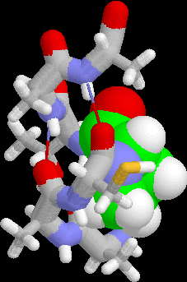
Examples of Classification Task
Banking: Credit/loan approval
Fraud detection: if a transaction is fraudulent
Detecting spam email messages based upon the message header and content
Medical diagnosis: Predicting tumor cells as benign or malignant based upon the results of MRI scans
Biology: Classifying secondary structures of protein as alpha-helix, beta-sheet, or random coil
Web page categorization: Categorizing news stories as finance, weather, entertainment, sports, etc

Slide 6
Classification Algorithms
Regression | Classification
Linear Regression | k-Nearest Neighbor (KNN)
Non-Linear Regression | Decision Tree
Random Forest | Naïve Bayes
Multilayer Perceptron | Support Vector Machine (SVM)
Convolutional Neural Network (CNN) | Artificial Neural Network (ANN)
etc | etc

Slide 7
Instance-Based Classifiers
What are they?
The simplest form of learning because no parameter needs to be learned.
Where is the knowledge?
The samples/instances themselves represent the knowledge
How do they learn?
Similarity function i.e. distance function defines learning. They are only active when a new instance must be classified.

Slide 8
Illustration
Store the training records
Use training records to predict the class label of unseen cases

Slide 9
Example: Animal Prediction
Basic idea: The given input is features.
If an instance has features (e.g. walking and quacking) like a duck, then it is a duck
Compute Distance
Test Record
Training Records
Choose k of the “nearest” records

Slide 10

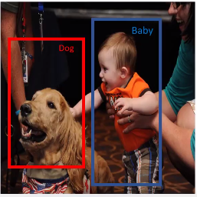
Example: Classification

Slide 11
Lazy Learner: Instance-Based Methods
Instance-based learning:
Store training examples and delay the processing (“lazy evaluation”) until a new instance must be classified.
Typical approaches:
k-nearest neighbor approach
Instances represented as points in a Euclidean space.
Locally weighted regression
Constructs local approximation.
Case-based reasoning
Uses symbolic representations and knowledge-based inference.

Slide 12
K-Nearest Neighbor (kNN) Classifier

Slide 13
k-Nearest Neighbors
What is it?
These are supervised learning algorithms where samples/instances are used (incrementally) to classify objects.
The k-NN classifier looks at k nearest neighbors of a new instance to decide which class the new instance should belong to.
When k=1, we have the nearest neighbor algorithm.
k-NN classifier does not have a training phase; all instances are stored as it is.
Problem:
During use or testing, k-NN classification algorithm has to find k nearest neighbors of a new instance. This is time consuming if we do exhaustive comparison.

Slide 14
k-Nearest Neighbors Classifier
Requires three things:
The set of stored records
Distance Metric to compute distance between records
The value of k, the number of nearest neighbors to retrieve
To classify an unknown record:
Compute distance to other training records
Identify k nearest neighbors
Use class labels of nearest neighbors to determine the class label of unknown record (e.g., by taking majority vote)

Slide 15
Definition of Nearest Neighbor
Unknown instance
K-nearest neighbors of an instance x are data points that have the k smallest distance to x.

Slide 16
Distance Between Two Points
Euclidean distance (continues variable)
Hamming distance (discrete variables)
cowok and cewek – distance is 2
seputar and saputra – distance is 3
Determine the class from nearest neighbor list
take the majority vote of class labels among the k-nearest neighbors
Weigh the vote according to distance; weight factor, w = 1/d²

Slide 17
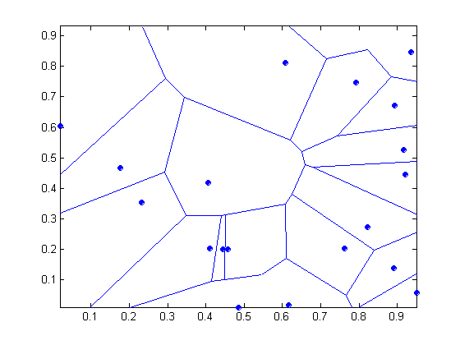
Voronoi Diagram (1-NN)
If we divide the classes (a set of points) into regions based on distance to point, we get this diagram

Slide 18
Choosing the Value of k
If K is too small, sensitive to noise points.
If K is too large, neighborhood may include too many points from other classes (irrelevant).

Slide 19
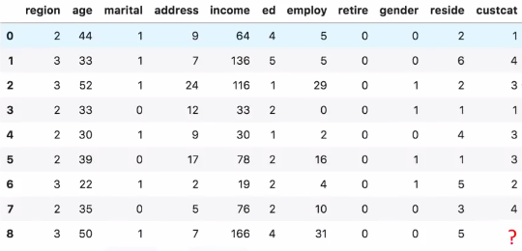
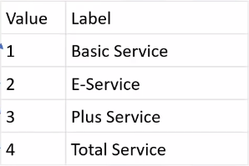
Example: telecommunication service
Below is the data from a telecommunication provider company:
The label is “custcat” (customet category), which represents type of service selected by the custouse mer.
label/class
new instance
Use k-NN to predict which service this customer will select.

Slide 20
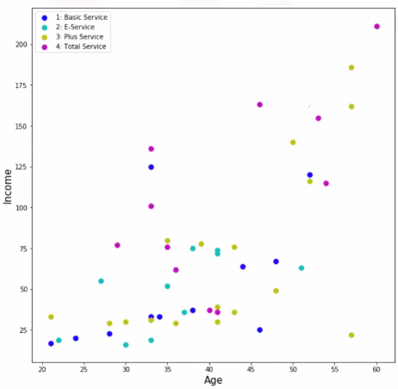
Example: telecommunication service (cont.)
Decide the class of the new instance using 1-NN classifier.
For simplicity, only use 2 variables: income and age.
Plot the 2 variables.
new instance

Slide 21
Example: telecommunication service (cont.) – 1-NN
New instance:
Age = 50
Income = 166
Which category this new customer belongs to?
Predicted category/class: Total Service
?
new instance

Slide 22
Exercise: Use 5-NN
For the same instance:
Age = 50
Income = 166
Which category this new customer belongs to if 5-NN is applied?
?

Slide 23
Summary on k-NN
K-NN classifiers are lazy learners
It does not build models explicitly
No explicit training phase required
Classifying unknown records are relatively expensive

Slide 24
Naïve Bayes Classifier

Slide 25
Introduction to Naïve Bayes
A statistical classifier: performs probabilistic prediction, i.e., predicts class membership probabilities
Foundation: Based on Bayes’ Theorem.
Performance: A simple Bayesian classifier, naïve Bayesian classifier, has comparable performance with decision tree and selected neural network classifiers
Incremental: Each training example can incrementally increase/decrease the probability that a hypothesis is correct — prior knowledge can be combined with observed data
Standard: Even when Bayesian methods are computationally intractable, they can provide a standard of optimal decision making against which other methods can be measured

Slide 26
Bayes Theorem: Basic
Total probability Theorem:
Bayes’ Theorem:
Let X be a data sample (“evidence”): class label is unknown
Let H be a hypothesis that X belongs to class C
Classification is to determine P(H|X), (i.e., posteriori probability): the probability that the hypothesis holds given the observed data sample X
P(H) (prior probability): the initial probability
E.g., X will buy computer, regardless of age, income, …
P(X): probability that sample data is observed
P(X|H) (likelihood): the probability of observing the sample X, given that the hypothesis holds
E.g., Given that X will buy computer, the probability that X is 31..40, medium income

Slide 27
Prediction Based on Bayes’ Theorem
Given training data X, posteriori probability of a hypothesis H, P(H|X), follows the Bayes’ theorem
Informally, this can be viewed as
posteriori = likelihood x prior/evidence
Predicts X belongs to C_{i} iff the probability P(C_{i}|X) is the highest among all the P(C_{k}|X) for all the k classes
Practical difficulty: It requires initial knowledge of many probabilities, involving significant computational cost

Slide 28
Classification is to Derive the Maximum Posteriori
Let D be a training set of tuples and their associated class labels, and each tuple is represented by an n-D attribute vector X = (x₁, x₂, …, x_{n})
Suppose there are m classes C₁, C₂, …, C_{m}.
Classification is to derive the maximum posteriori, i.e., the maximal P(C_{i}|X)
This can be derived from Bayes’ theorem
Since P(X) is constant for all classes, only needs to maximize:

Slide 29
Naïve Bayes Classifier
A simplified assumption: attributes are conditionally independent (i.e., no dependence relation between attributes):
This greatly reduces the computation cost: Only counts the class distribution
If A_{k} is categorical, P(x_{k}|C_{i}) is the # of tuples in C_{i} having value x_{k} for A_{k} divided by |C_{i, D}| (# of tuples of C_{i} in D)
If A_{k} is continous-valued, P(x_{k}|C_{i}) is usually computed based on Gaussian distribution with a mean μ and standard deviation σ
and P(x_{k}|C_{i}) is

Slide 30
Naïve Bayes Classifier: Training Dataset
Class:
C1:buys_computer = ‘yes’
C2:buys_computer = ‘no’
Data to be classified:
X = (age <=30,
income = medium, student = yes
credit_rating = fair)

Slide 31
Naïve Bayes Classifier: Example
P(C_{i}): P(buys_computer = “yes”) = 9/14 = 0.643
P(buys_computer = “no”) = 5/14= 0.357
Compute P(X|C_{i}) for each class
P(age = “<=30” | buys_computer = “yes”) = 2/9 = 0.222
P(age = “<= 30” | buys_computer = “no”) = 3/5 = 0.6
P(income = “medium” | buys_computer = “yes”) = 4/9 = 0.444
P(income = “medium” | buys_computer = “no”) = 2/5 = 0.4
P(student = “yes” | buys_computer = “yes) = 6/9 = 0.667
P(student = “yes” | buys_computer = “no”) = 1/5 = 0.2
P(credit_rating = “fair” | buys_computer = “yes”) = 6/9 = 0.667
P(credit_rating = “fair” | buys_computer = “no”) = 2/5 = 0.4
X = (age <= 30 , income = medium, student = yes, credit_rating = fair)
P(X|C_{i}) : P(X|buys_computer = “yes”) = 0.222 x 0.444 x 0.667 x 0.667 = 0.044
P(X|buys_computer = “no”) = 0.6 x 0.4 x 0.2 x 0.4 = 0.019
P(X|C_{i})*P(C_{i}) : P(X|buys_computer = “yes”) * P(buys_computer = “yes”) = 0.028
P(X|buys_computer = “no”) * P(buys_computer = “no”) = 0.007
Therefore, X belongs to class (“buys_computer = yes”)

Slide 32
Avoiding the Zero-Probability Problem
Naïve Bayesian prediction requires each conditional prob. be non-zero. Otherwise, the predicted prob. will be zero
Ex. Suppose a dataset with 1000 tuples, income=low (0), income= medium (990), and income = high (10)
Use Laplacian correction (or Laplacian estimator)
Adding 1 to each case
Prob(income = low) = 1/1003
Prob(income = medium) = 991/1003
Prob(income = high) = 11/1003
The “corrected” prob. estimates are close to their “uncorrected” counterparts.

Slide 33
Summary on Naïve Bayes
Advantages
Easy to implement
Good results obtained in most of the cases
Robust to isolated noise points
Handle missing values by ignoring the instance during probability estimate calculations
Robust to irrelevant attributes
Independence assumption may not hold for some attributes
Used by other techniques such as Bayesian Belief Networks (BBN)

Slide 34
Decision Tree

Slide 35
Decision Tree
A decision tree is a flowchart-like tree structure where an internal node represents feature (or attribute), the branch represents a decision rule, and each leaf node represents the outcome.
top-down approach
The topmost node is known as the root node.
It learns to partition based on the attribute value.
It partitions the tree in a recursive manner called recursive partitioning.
It mimics the human-level thinking.
Easy to understand and interpret.

Slide 36
Terminologies
Root Node (Top Decision Node): It represents the entire population and this further gets divided into two or more homogeneous sets.
Splitting: It is a process of dividing a node into two or more sub-nodes.
Decision Node: When a sub-node splits into further sub-nodes, then it is called a decision node.
Leaf/Terminal Node: Nodes with no children (no further split) is called Leaf or Terminal node.
Pruning: When we reduce the size of decision trees by removing nodes (opposite of Splitting), the process is called pruning.
Branch/Sub-Tree: A sub section of the decision tree is called branch or sub-tree.
Parent and Child Node: A node, which is divided into sub-nodes is called a parent node of sub-nodes whereas sub-nodes are the child of a parent node.

Slide 37
Constructing Decision Tree
Strategy: top-down approach
Select the best attribute using Attribute Selection Measures (ASM) to split the records.
Make that attribute a decision node and breaks the dataset into smaller subsets.
Starts tree building by repeating this process recursively for each child until one of the following conditions will match:
All the tuples belong to the same attribute value.
There are no more remaining attributes.
There are no more instances.

Slide 38
Attribute Selection Measure (ASM)
ASM is a heuristic for selecting the splitting criterion that partition data into the best possible manner, also known as splitting rules.
Most popular selection measures:
Information Gain
Gain Ratio
Gini Index

Slide 39
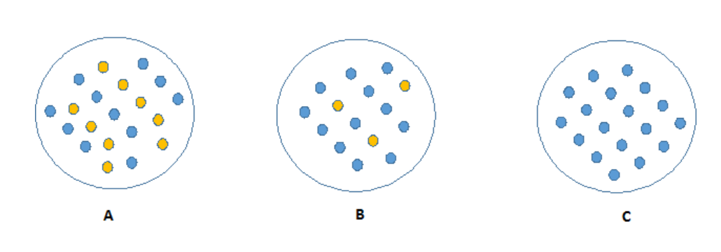
(Im)purity
The order of impurity (highest to lowest): A – B – C

Slide 40
Information Gain and Entropy
Information gain is a measure of a reduction of uncertainty.
It increases with the average purity of the subsets.
To compute information gain, we need to compute entropy.
Entropy measures the impurity (or randomness) of a dataset.

Slide 41
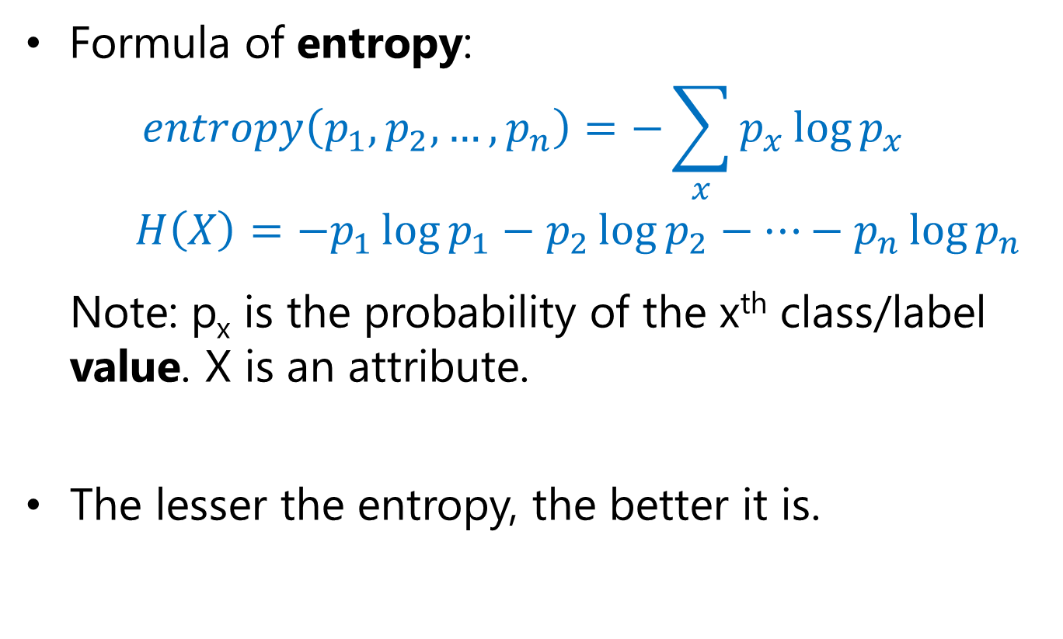
Entropy
(log base 2)
Lower entropy means less random data distribution.
Higher entropy means more random data distribution

Slide 42
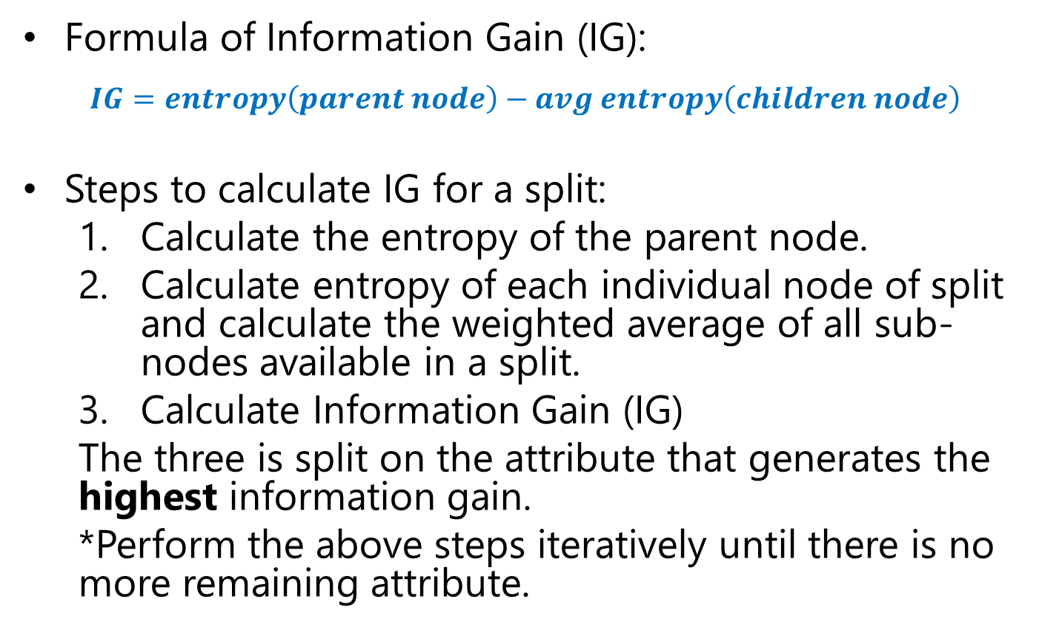
Information Gain to Construct a Decision Tree

Slide 43
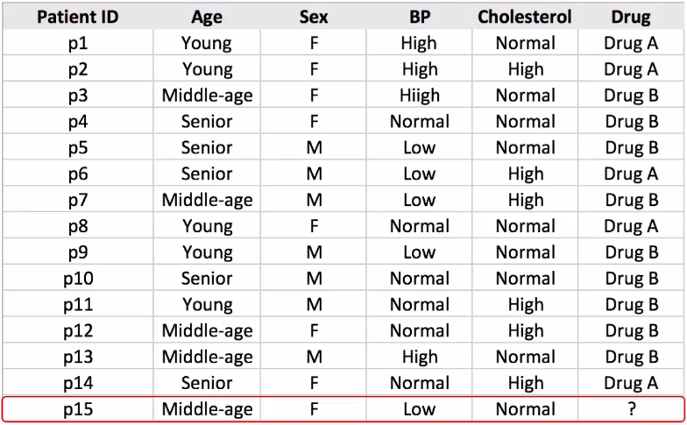
Example: Drug Treatment
Build a decision tree based on the dataset below using Information Gain as the criteria!

Slide 44
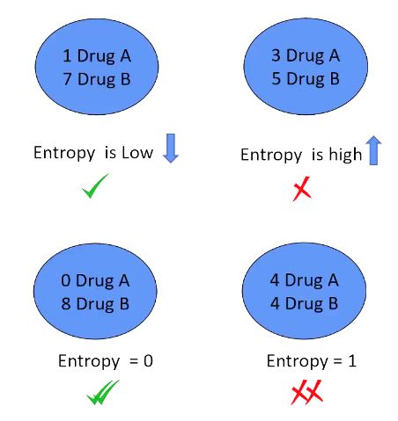
Understanding Entropy (Drug-Treatment Example)
distribution of class labels based on a particular attribute value

Slide 45
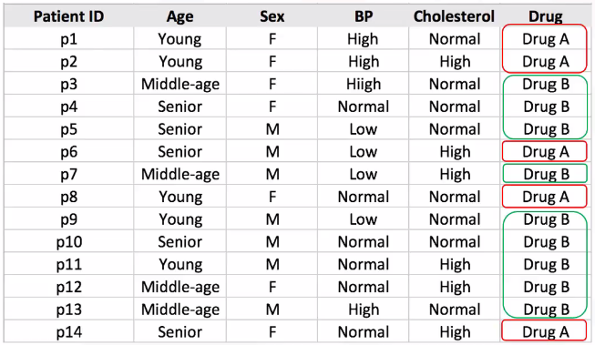
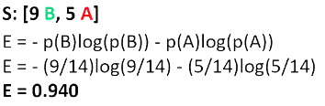
Constructing Decision Tree: Drug-Treatment Example
entropy before splitting
Next step: calculate entropy for each attribute, and then calculate information gain (IG). The one that has the highest IG will be selected as the root of the tree.

Slide 46
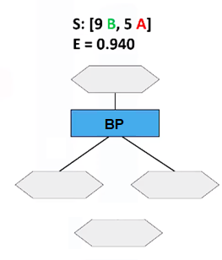
Constructing Decision Tree: Drug-Treatment Example (cont.)
Entropy for “Age”
Age
Young
Senior
Middle-age
S: [2 B, 3 A]
E = 0.971
S: [3 B, 2 A]
E = 0.971
S: [4 B, 0 A]
E = 0

Slide 47
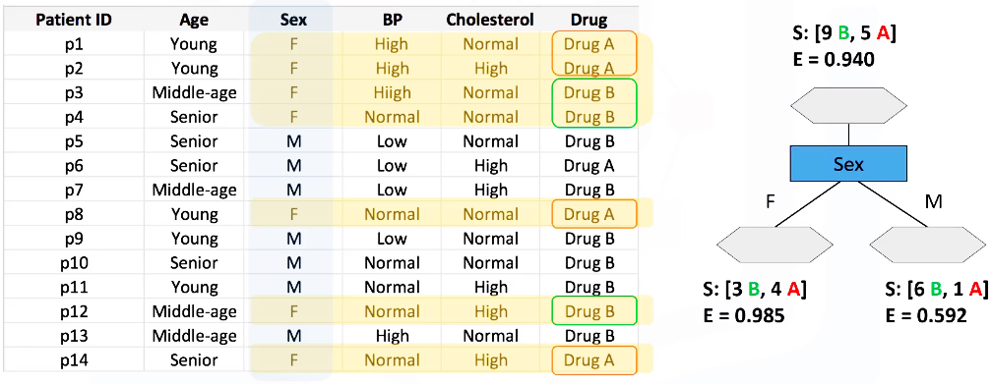
Constructing Decision Tree: Drug-Treatment Example (cont.)
Entropy for “Sex”

Slide 48
Constructing Decision Tree: Drug-Treatment Example (cont.)
Entropy for “BP”
High
Low
Normal
S: [2 B, 2 A]
E = 1.00
S: [3 B, 1 A]
E = 0.811
S: [4 B, 2 A]
E = 0.918
Notes:
BP: Blood Pressure

Slide 49
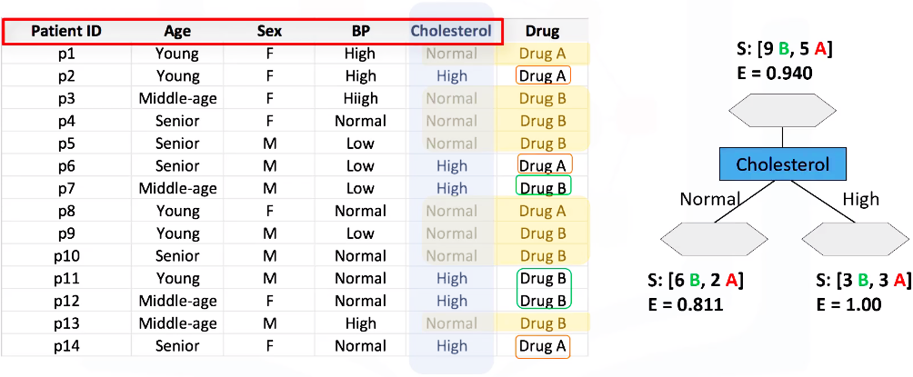
Constructing Decision Tree: Drug-Treatment Example (cont.)
Entropy for “Cholesterol”

Slide 50
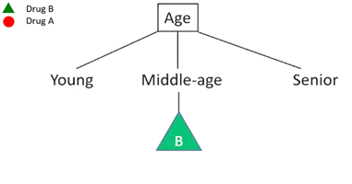
Constructing Decision Tree: Drug-Treatment Example (cont.)
Summary
Decision Tree:
Information Gain (IG) | Information Gain (IG)
IG(class, Age) | 0.246
IG(class, Sex) | 0.152
IG(class, BP) | 0.029
IG(class, Cholesterol) | 0.048
Repeat the process for each unfinished branch.
Stop when all the leaves are class values.

Slide 51
Advanced Methods in Classification (Introduction)
Artificial Neural Network (ANN) Support Vector Machine (SVM)

Slide 52
1. Artificial Neural Network (ANN)

Slide 53
Let’s Start with Perceptron
Output Y is 1 if at least two of the three inputs are equal to 1.

Slide 54
Perceptron

Slide 55




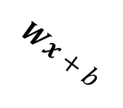







General Structure of Perceptron
Yes
No
Linear Function
Step Function

Slide 56
Artificial Neural Network
Training ANN means learning the weights of the neurons

Slide 57
How a Multi-Layer ANN Works
The inputs to the network correspond to the attributes measured for each training tuple.
Inputs are fed simultaneously into the units making up the input layer.
They are then weighted and fed simultaneously to a hidden layer.
The number of hidden layers is arbitrary, although usually only one.
The weighted outputs of the last hidden layer are input to units making up the output layer, which emits the network's prediction.
The network is feed-forward: None of the weights cycles back to an input unit or to an output unit of a previous layer.
From a statistical point of view, networks perform nonlinear regression: Given enough hidden units and enough training samples, they can closely approximate any function.

Slide 58
2. Support Vector Machine (SVM)

Slide 59
Support Vector Machine (SVM)
A relatively new classification method for both linear and nonlinear data.
It uses a nonlinear mapping to transform the original training data into a higher dimension.
With the new dimension, it searches for the linear optimal separating hyperplane (i.e., “decision boundary”).
With an appropriate nonlinear mapping to a sufficiently high dimension, data from two classes can always be separated by a hyperplane.
SVM finds this hyperplane using support vectors (“essential” training tuples) and margins (defined by the support vectors).

Slide 60
SVM: General Philosophy
Small Margin
Large Margin
Support Vectors

Slide 61
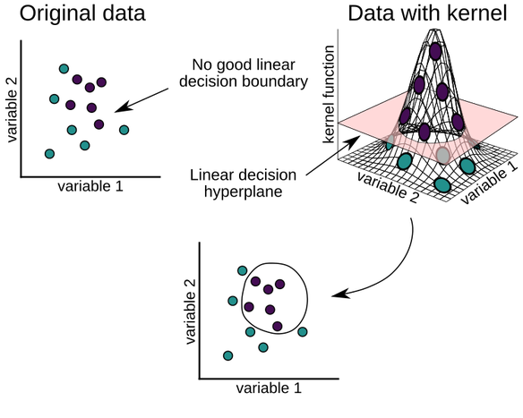
SVM Principle
Notes:
Source of image: https://machinelearningwithmlr.files.wordpress.com/2019/10/ch06_fig_5_mlr.png?w=584

Slide 62
ANN vs SVM
ANN
Nondeterministic algorithm
Generalizes well but doesn’t have strong mathematical foundation
Can easily be learned in incremental fashion
To learn complex functions—use multilayer perceptron (nontrivial)
SVM
Deterministic algorithm
Nice generalization properties
Hard to learn – learned in batch mode using quadratic programming techniques
Using kernels can learn very complex functions
62

Slide 63
References
Bishop, C. M. (2006). Pattern recognition and machine learning. springer.
Mitchell, Tom M. (1997). Machine learning. McGraw Hill.
Flach, P. (2012). Machine learning: the art and science of algorithms that make sense of data. Cambridge University Press.
Harrington, P. (2012). Machine learning in action. Manning Publications Co..

Slide 64
Q&A

Slide 65
Thank You

